Slide 1
Proportions of Transportation Methods Used by STA304 Students

Slide 2
Our Goal
To study how STA304 students at UTM travel to school
We wish to learn if there is a connection between how far a student is from UTM, and the method of transportation they use to get to school
Modes of Transportation (MODs) include
Public transit
Driving
Carpool
Non-motorized transportation (ie walking, bikes)
Shuttle
Some combination of the others

Slide 3
Hypothesis
That distance from UTM effects the MOD s/he chooses to use
We anticipate that living further away from campus encourages the use of cars, whether that means driving independently or carpooling.
In addition, we believe that living close to campus would entice students to use public transportation
Parking on Campus is expensive

Slide 4
Sampling
We used Simple Random Sampling
Population:
Currently enrolled STA304 students at UTM
104 students sampled out of 297
CLT applies
We sent out a questionnaire asking students how far away they live and how they get to school
We took the data from these questionnaires and segregated students based on their mode of transportation (MOT), and then from each MOT we find the proportions of students at each distance away from UTM.

Slide 5
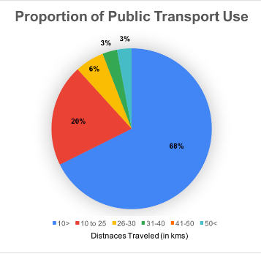

Slide 6
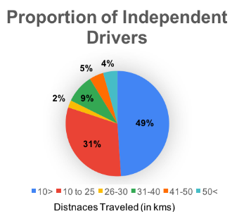

Slide 7
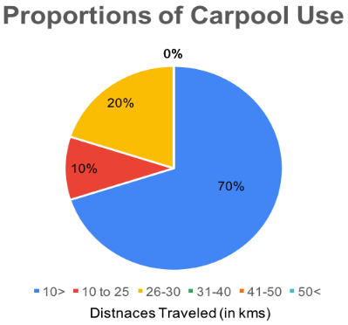

Slide 8
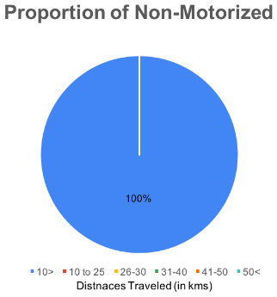

Slide 9
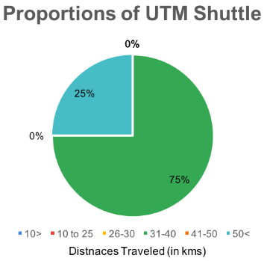

Slide 10
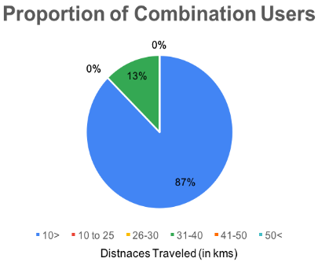

Slide 11
